Slide 1

Mini Project-II (ID201B) Even Semester Session 2024-25
MIND SHARPER
Name :- Sandali Srivastava 2426mca803
Name:- Sakshi Tripathi 2426mca698
Name:- Samiksha Teotia 2426mca838
Project Supervisor:
Dr. Vipin Kumar
Associate Professor

Slide 2
Content
Introduction
Literature Review
Objective
Technology
Modules
Workflow
References
Notes:
Font Styles: Times New Roman + Font Size: 25

Slide 3
Introduction
An Online Mind sharper game is a digital version of the classic card-matching game designed to test and improve players' memory and concentration skills.
The primary objective is to match pairs of identical cards or images by flipping them over. These games are popular across different age groups and are often used for entertainment, education, or brain training.
It Works:
Card Setup: A set of cards is placed face down in a grid layout.
Flipping Cards: Players flip two cards at a time, trying to find matching pairs.
Matching Pairs: If the cards match, they remain face-up; if not, they flip back face down.
Game Completion: The game continues until all pairs are matched .
Scoring: Some versions include a scoring system based on the number of moves or time taken.
Notes:
Font Styles: Times New Roman + Font Size: 25

Slide 4
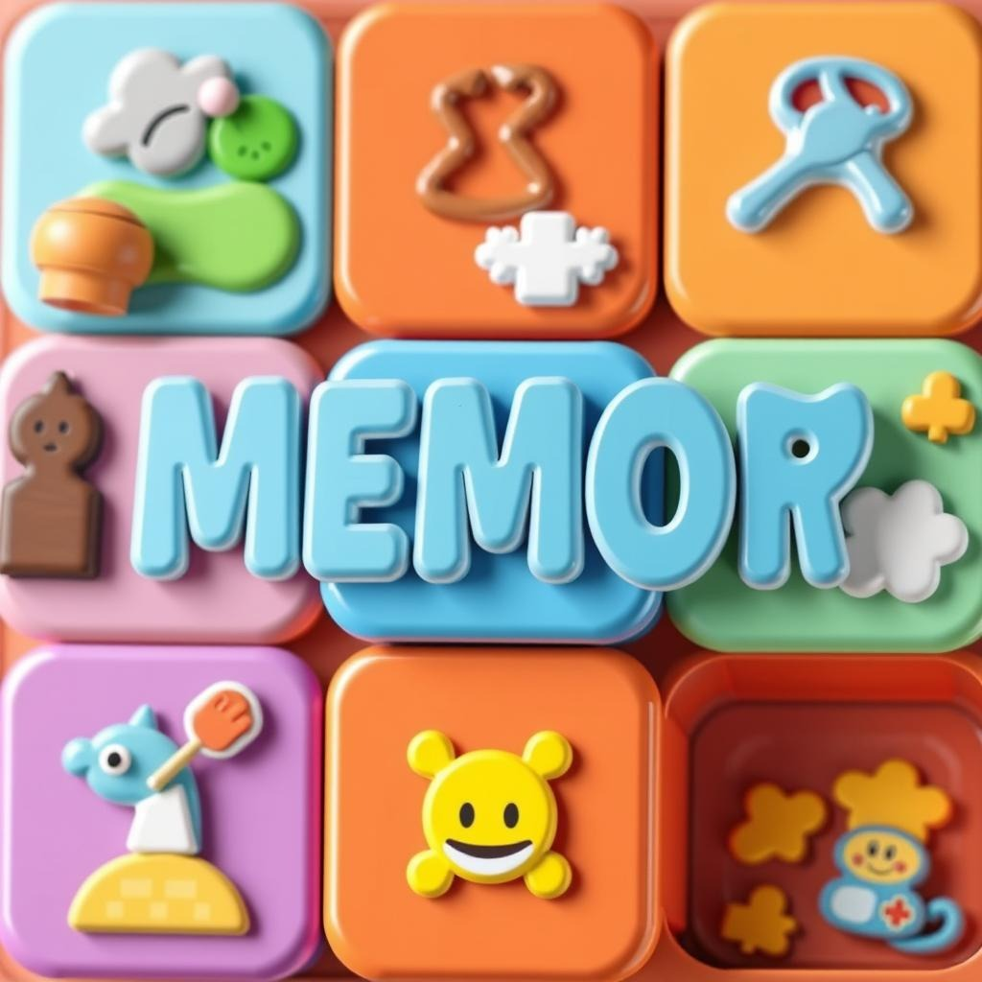
Literature Review
Memory games have been widely studied in cognitive psychology, neuroscience, and education for their role in enhancing memory, concentration, and cognitive abilities. This literature review examines existing research on the impact of memory games on cognitive development, their applications in education and healthcare, and technological advancements in online memory games.
Notes:
Font Styles: Times New Roman + Font Size: 25

Slide 5
Literature Review
1.1 Cognitive Benefits :-
Improves Memory Retention – Memory games strengthen short-term and long-term memory by encouraging recall and recognition.
Enhances Concentration and Focus – Players must stay attentive, improving attention span and cognitive control.
1.2 Educational Benefits :-
Enhances Learning in Children – Used in language learning, math, and science to improve knowledge retention.
Interactive and Engaging – Gamification increases student motivation compared to traditional learning.
Notes:
Font Styles: Times New Roman + Font Size: 25

Slide 6
Objective of the Project
The main objective of a mind sharper game is to test and improve a player's memory and concentration by matching pairs of identical cards, images, or symbols. The game challenges players to recall and identify matching elements while minimizing the number of moves or the time taken to complete the game.
Key Objectives:
Find All Matching Pairs Players must memorize the positions of the cards and find all identical pairs by flipping them over.
Enhance Memory Skills The game trains short-term memory by encouraging players to remember card placements after each turn.
Improve Focus and Concentration Players must stay focused and attentive to remember previously revealed cards.
Complete the Game Efficiently Minimize the number of moves – The fewer attempts made to find all pairs, the better the score . Beat the timer (if applicable) – Some versions reward players for completing the game within a set time.
Notes:
Font Styles: Times New Roman + Font Size: 25

Slide 7
Technology
Programming Languages :
JAVA (JDK 23)
Development Environment :
Eclipse or Visual studio code ,SQL
Notes:
Font Styles: Times New Roman + Font Size: 25

Slide 8
Modules
A Mind Sharper Game can be divided into several key modules, each responsible for a specific aspect of the game.
1.User Interface (UI) Module:
Purpose: Manages the graphical layout and user interactions.
Card Flip Animation – Visual effect for flipping cards.
Card Matching Logic – Checks if two flipped cards are identical.
2.Timer & Scoring Module
Purpose: Manages time tracking and scoring system.
3. Game Logic Module:
Purpose: Controls the core mechanics of the game.
Notes:
Font Styles: Times New Roman + Font Size: 25

Slide 9
Workflow
Planning and Design : Number of cards, pairs, turns, scoring, and special features.
Choose card designs: Images, icons, emojis, or custom graphics .
Design the game interface: Grid layout, buttons, score display, and animations.
Player Interaction Purpose: Handle user input when a player selects cards.
Steps: The player clicks/taps on a card to flip it. The card’s image is revealed .
The player selects a second card.
Card Matching Logic Purpose:
Check if the two selected cards are a matching pair.
If the two cards match: Keep them face-up. Increase the score.
If the two cards do not match: Wait for a short delay. Flip the cards back face-down. Increase the move count.
Notes:
Font Styles: Times New Roman + Font Size: 25

Slide 10
References
Google
ChatGPT
YouTube Videos
Notes:
Font Styles: Times New Roman + Font Size: 25

